Slide 1
Supervised Discretization
Prof.Aruna Malapati

Slide 2
Learning Objective
Apply supervised discretization methods to any data set
Define Entropy and Information Gain

Slide 3
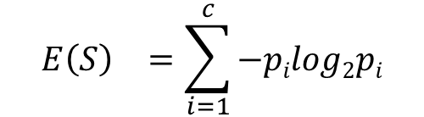
Entropy
Entropy E(S) - measure of the impurity/uncertanity in a group of examples
S - training set with C₁,...,C_{C} classes
p_{i} - proportion of C_{c}
Very impure group
Less impure group
Pure group

Slide 4
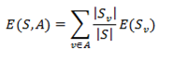
Information Gain
Information gain (IG) measures how much “information” a feature gives us about the class.
Features that perfectly partition should give maximal information.
Unrelated features should give no information.
It
Where S is the number of samples in the training set, with S_{v} instances belonging to class i, where i = 1, … , c.

Slide 5
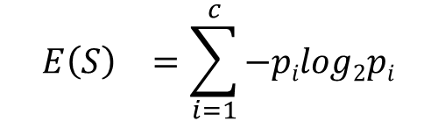
Supervised Discretization - Entropy Based
Entropy Based Discretization
Sort examples in increasing order
Each value forms an interval (m intervals)
Calculate the entropy measure of this discretization
Calculate "Entropy" for the target given a bin.
Calculate "Information Gain" given a bin. E(S) - E(S,A)
Apply the process recursively until some stopping criterion is met.
E(S) - E(S,A) > δ
${E\left(S\right)}^{}=\sum_{i=1}^{c}{−pilog2pi}$

Slide 6
Supervised Discretization Example
Runs | 53 | 56 | 57 | 63 | 66 | 67 | 67 | 67 | 68 | 69 | 70 | 70 | 70 | 70 | 72 | 73 | 75 | 75 | 76 | 76 | 78 | 79 | 80 | 81
Matches Won | Y | Y | Y | N | N | N | N | N | N | N | N | Y | Y | Y | N | N | N | Y | N | N | N | N | N | N
In this example we are discretizing the feature Runs using 2 bins <=60 and >60.
Step 3: Calculate "Entropy" for the target.
Step 4: Calculate "Entropy" for the target given a bin.
Runs
Y | N
7 | 17
 |  | Matches Won
 |  | Y | N
Runs | <= 60 | 3 | 0
 | > 60 | 4 | 17
E (Runs) = E(7, 17) = E(0.29, .71)
= -0.29 x log₂(0.29) - 0.71 x log₂(0.71)
= 0.871
E (Matches Won,Runs) = P(<=60) x E(3,0) + P(>60) x E(4,17)
= 3/24 x 0 + 21/24 x 0.7= 0.615
Step 5: Calculate "Information Gain" given a bin.
Information Gain (Matches Won,Runs) = 0.256

Slide 7
Supervised Discretization Example (Contd..)
Runs | 53 | 56 | 57 | 63 | 66 | 67 | 67 | 67 | 68 | 69 | 70 | 70 | 70 | 70 | 72 | 73 | 75 | 75 | 76 | 76 | 78 | 79 | 80 | 81
Matches Won | Y | Y | Y | N | N | N | N | N | N | N | N | Y | Y | Y | N | N | N | Y | N | N | N | N | N | N
 |  | Matches Won
 |  | Y | N
Runs | <= 60 | 3 | 0
 | > 60 | 4 | 17
 |  | Matches Won
 |  | Y | N
Runs | <= 70 | 6 | 8
 | > 70 | 1 | 9
 |  | Matches Won
 |  | Y | N
Runs | <= 75 | 7 | 11
 | > 75 | 0 | 6
Information Gain = 0.256
Information Gain = 0.101
Information Gain = 0.148

Slide 8
Thank You!
In our next session: Binarization

